Slide 1
Linear Layouts:
Robust Code Generation of Efficient Tensor Computation Using F₂
Reg
Thr
Wrp
q₀
q₁
t₀
t₁
t₂
t₃
t₄
w
j₀
1
0
0
0
0
0
0
0
j₁
0
0
1
0
0
0
0
0
j₂
0
0
0
1
0
0
0
0
ASPLOS ’26 paper presentation · March 22–26, 2026 · DOI 10.1145/3760250.3762221
j₃
0
0
0
0
1
0
0
0
Paper authors: Keren Zhou; Mario Lezcano-Casado; Adam P. Goucher; Akhmed Rakhmati; Jeff Niu; Justin Lebar; Pawel Szczerbuk; Peter Bell; Phil Tillet; Thomas Raoux; Zahi Moudallal
i₀
0
1
0
0
0
0
0
0
i₁
0
0
0
0
0
1
0
0
Keren Zhou — George Mason University (also listed with OpenAI); the remaining authors are listed with OpenAI affiliations in the paper.
i₂
0
0
0
0
0
0
1
0
i₃
0
0
0
0
0
0
0
1
Layout A (Figure 1) as a binary matrix: hardware bits → tensor-coordinate bits
Ragimanu Jeevan | Student No. 26965
M.Tech CSA, IISc Bangalore
E0358 Advanced Techniques in Compilation and Programming for Parallel Architectures
Notes:
[~1:00]
Good morning everyone. I am Ragimanu Jeevan, and I will present the ASPLOS 2026 paper "Linear Layouts: Robust Code Generation of Efficient Tensor Computation Using F2".
The central question of the paper: how can a compiler describe and transform the complex mappings between tensor indices and hardware — registers, threads, warps, and memory — without writing a custom rule for every pair of layouts?
The answer is in the small matrix on the right. It is Layout A from the paper's Figure 1 — an ordinary Triton blocked layout — written as a matrix of zeros and ones. By the end of the talk you will be able to read it: each column is one hardware bit, each row is one bit of a tensor coordinate, and multiplying with XOR and AND tells you which tensor element a register holds.

Slide 2
Where we are going
ROADMAP
1
2
3
4
5
Why layouts matter
Linear Layouts math
Code generation
Evaluation
Takeaways
GPU hierarchy, Triton, legacy layout zoo
§4 — Layout A as a matrix, four operations, what the theorems guarantee
§5 — how §4 picks instructions; layout conversion and swizzling with the paper’s figures
§6 — micro-benchmarks and 265 real cases
Limitations, source code, Q&A
Technical core — binary matrices + worked examples
Through-line: represent a layout as a bit-level linear map → compose / invert maps to derive conversions → lower them to registers, shuffles, vector loads and swizzled shared memory.
Notes:
[~0:45]
Five parts. First, why layouts matter on GPUs and why the old approach in Triton was painful. Second, the technical core, Section 4: the paper's Layout A as a binary matrix, the four operations on layouts and why they matter, and what the theorems guarantee. Third, Section 5: how these tools decide which instructions the compiler emits, with the two central algorithms — layout conversion with warp shuffles and optimal swizzling — shown with the paper's figures. Then the evaluation and the takeaways.
The through-line: represent layouts as bit-level linear maps, compose and invert them to derive conversions, then lower those conversions to efficient GPU instructions.

Slide 3
What the paper contributes
§1 INTRODUCTION · CONTRIBUTIONS
1
REPRESENTATION
2
SYSTEM
3
ALGORITHMS
4
EVALUATION
Linear layouts
Built into Triton
New algorithms
Faster and more robust
Tensor layouts as linear maps over F₂: binary matrices on index bits
Layouts compose, invert and divide in one unified framework
Fully integrated into Triton’s GPU backend
A layout engine that automatically chooses and propagates layouts for any Triton operation
Optimal swizzling: provably max vectorization, min bank conflicts
Optimal warp-shuffle generation
Generic lowering of hardware intrinsics for the whole family
Synthetic + real DL workloads: up to 1.40×, avg 1.07× over 265 cases
Fixes many pre-existing layout bugs in Triton
In this talk: §4
In this talk: §4.4
In this talk: §5
In this talk: §6
“One composable representation instead of case-by-case layout conversion code.”
Source: Contributions list in §1 Introduction, p. 134; Abstract, p. 132
Notes:
[~1:00]
The paper lists four contributions, and the talk follows the same order.
One, the representation: linear algebra over F2 represents tensor layouts and composes them in one framework — a layout becomes a binary matrix on the bits of a hardware index. That is Section 4.
Two, the system: linear layouts are fully integrated into Triton's GPU backend, with a layout engine that chooses and propagates layouts for any Triton operation — Section 4.4.
Three, the algorithms: optimal swizzling that provably maximizes vectorization and minimizes bank conflicts, optimal warp-shuffle generation for layout conversions, and generic lowering of hardware intrinsics for every layout — Section 5.
Four, the evidence: up to 1.40× and on average 1.07× over baseline Triton across 265 real cases, plus many layout bugs fixed — Section 6. The large speedups come from micro-benchmarks; end-to-end gains are modest.
In one line: one composable representation instead of case-by-case layout conversion code.

Slide 4
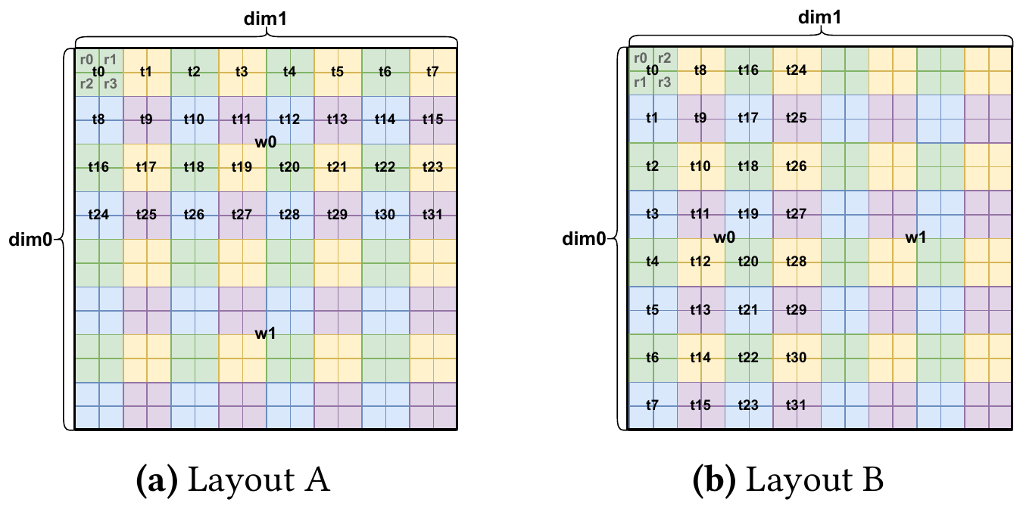
Same 16×16 tensor, two different layouts
MOTIVATION
A logical shape does not determine who holds which element.
Layout A: each thread owns a 2×2 tile; threads tile rows of 8 → coalesced reads for a row-major tensor.
Layout B: the same values with threads running down columns → access efficiency changes.
A layout = a mapping from hardware locations to tensor elements.
Figure 1. Two layouts storing a 16×16 tensor using two warps (wᵢ warp, tⱼ thread, rₖ register).
Source: Figure 1 and §1 Introduction, p. 133
Notes:
[~1:15]
This is Figure 1 of the paper. Both pictures store the same 16 by 16 tensor with two warps. Each small cell is one tensor element. The labels tell us who owns it: w_i is warp i, t_j is thread j, r_k is register k.
In Layout A on the left, each thread owns a 2 by 2 tile — four registers r0..r3 — and the 32 threads of warp 0 are arranged 4 rows by 8 columns, so warp 0 covers the top 8 rows and warp 1 the bottom 8 rows.
In Layout B on the right, threads are arranged down the columns instead: t0..t7 go down the first column of tiles.
The logical tensor is identical; only the ownership changes. The paper notes that if the tensor sits in row-major order in memory, loading it into Layout A is more efficient than into Layout B, because neighbouring threads touch neighbouring addresses — the loads are coalesced.
So a layout is a hardware mapping, not just a shape or a row-major/column-major label. In Section 4 we will build the binary matrix of Layout A, step by step.

Slide 5
Why the legacy approach is painful
MOTIVATION
Legacy layouts are separate types: Blocked, Sliced, MMA, MMA Input, Unswizzled, Swizzled.
Each type implements its own properties, indexing and conversions case by case.
Codegen leans on heuristics (e.g. shared-memory padding) that suit common patterns only.
New layouts multiply maintenance and correctness burden — the paper reports 12% of Triton bugs filed were layout-related.
Blocked
Sliced
MMA
MMA In
Unswz
Swz
Blocked
Sliced
MMA
source
MMA In
Unswz
Swz
Illustrative: rows = source, columns = destination. 6 types → up to 6×5 = 30 hand-written conversion paths.
With Linear Layouts, every conversion is derived from two matrices (B⁻¹ ∘ A) instead of being written for each pair.
Source: §1 Introduction, pp. 132–133; §3 Overview, p. 135
Notes:
[~1:00]
In legacy Triton, layouts were separate types: Blocked, Sliced, MMA, MMA Input, and for memory Unswizzled and Swizzled. Each type had to implement its own interface — elements per thread, contiguous elements, indexing — and every conversion between a pair of types had to be written by hand.
The grid on the right shows the problem: with N layout types you can face up to N squared source-destination combinations; with these six, up to 30 conversion paths. Adding one new layout means touching many places. Legacy Triton also relied on heuristics, such as padding shared memory, which work for common access patterns but not for complex ones.
The paper reports that, at the time cited, 12% of the bugs filed in Triton's GitHub repository were layout-related. That is the paper's observation at that time, not a claim about compilers in general today.
With linear layouts, a conversion is derived from two matrices instead of being written for each pair. We will see an early measurement of this — Figure 2, a float8 transpose — in the results section.

Slide 6
GPU background: where can a tensor element live?
BACKGROUND · §2.1
CTA (thread block)
Registers — private to each thread (lane).
Warp shuffle — lane-to-lane exchange inside a warp, no memory round-trip.
Shared memory — cooperative on-chip storage, split into banks.
MMA / WGMMA (NVIDIA), MFMA (AMD) — matrix multiply-accumulate instructions that dictate operand and output layouts.
Warp w₀ (32 lanes)
Warp w₁ (32 lanes)
t₀
t₁
t₂
…
t₀
t₁
t₂
…
r₀
r₀
r₀
r₀
r₀
r₀
r₀
r₀
r₁
r₁
r₁
r₁
r₁
r₁
r₁
r₁
r₂
r₂
r₂
r₂
r₂
r₂
r₂
r₂
r₃
r₃
r₃
r₃
r₃
r₃
r₃
r₃
registers are private to a lane
registers are private to a lane
Shared memory
Global memory (HBM/GDDR)
Tensor memory
on-chip, shared by the CTA, banked
large, off-chip
special unit memory (e.g. Blackwell)
Source: §2.1 GPU Architectures, pp. 133–134
Notes:
[~1:15]
Quick hardware vocabulary, since the matrices use it.
A CTA — cooperative thread array — is roughly a CUDA thread block. It contains several warps. A warp is a group of hardware threads that execute together: 32 on NVIDIA, 32 or 64 on AMD. Each thread, also called a lane, has private registers; when one thread holds several tensor elements they sit in several registers, which is why "Reg" is the first input dimension of a layout.
Data can move in a few ways. Within a thread: just rename registers — free. Within a warp: warp shuffle instructions let lanes exchange values without memory. Across warps: through shared memory, an on-chip scratchpad shared by the CTA, organised in banks — that becomes important for swizzling. Global memory (HBM or GDDR) is the large off-chip memory. Newer GPUs add special memories such as Tensor Memory on Blackwell.
Finally, matrix-multiply instructions: mma on NVIDIA tensor cores, wgmma (warp-group MMA, Hopper) and mfma on AMD. These instructions dictate exactly which lane and register must hold which operand element. That is the source of many required layouts. I will use NVIDIA names, but the paper notes AMD and Intel have analogous instructions.

Slide 7
Triton and its compiler pipeline (conceptual)
BACKGROUND · §2.2
compile time
run time
Python
TTIR
TTGIR
LLVM IR
PTX / AMDGCN
GPU
Triton kernel (tiles)
tt dialect
ttg dialect: tensors carry layouts
loads, shuffles, math
target ISA
execution
▲ Linear Layouts live here: layout assignment, propagation and conversion
Triton is a Python-like DSL for GPU kernels; the programmer thinks in tiles per CTA.
Values in TTGIR carry layouts; layout analysis and instruction selection happen at compile time.
The GPU only executes the generated loads, shuffles, math and stores — it never "solves" a layout matrix.
Source: §2.2 Triton Language and Compiler, p. 134; upstream triton-lang/triton
Notes:
[~1:00]
Triton is a Python-like domain-specific language for writing GPU kernels at the level of tiles. A kernel follows the single-program-multiple-data model: you write the program for one CTA, and a tensor in Triton means a tile.
Compilation goes through MLIR dialects. Python is turned into the Triton dialect, tt, then into the TritonGPU dialect, ttg. In ttg every tensor value carries a layout attribute. For example, operands of tt.dot get the mma layout so tensor cores can be used. Then it is lowered to LLVM IR and to PTX for NVIDIA or AMDGCN for AMD. Exact stages differ by target, so treat this as a conceptual pipeline.
The important point is the dashed line: all layout reasoning happens at compile time. The GPU is not multiplying 8 by 8 binary matrices for every element at run time. The compiler uses the matrices to decide which loads, shuffles, register moves and stores to emit; at run time the GPU just executes those instructions. Where an index really depends on runtime values, the generated code is a few XORs and shifts.

Slide 8
The only algebra we need: F₂
BACKGROUND · §2.4
⊕ (XOR) | 0 | 1
0 | 0 | 1
1 | 1 | 0
· (AND) | 0 | 1
0 | 0 | 0
1 | 0 | 1
Row view
1
1
1
0
y₀ = 1·1 ⊕ 1·1 = 1 ⊕ 1 = 0
y₁ = 0·1 ⊕ 1·1 = 0 ⊕ 1 = 1
×
=
0
1
1
1
F₂ = {0, 1}. Addition = XOR, multiplication = AND. So 1 ⊕ 1 = 0.
A
x
y
Matrix product: c₍ᵢⱼ₎ = ⊕ₖ aᵢₖ · bₖⱼ (AND, then XOR).
Bit vectors are written least-significant bit first.
All sizes are powers of two → every index is a bit vector.
Column view (used throughout the talk)
A x = XOR of the columns of A where x has a 1:
1
1
0
Column k = image of hardware bit k (Triton calls these the bases).
⊕
=
0
1
1
col 0
col 1
y
Source: §2.4 F₂ Mathematics, p. 135; column view as in LinearLayout.h comments
Notes:
[~1:00]
Everything in the paper uses arithmetic over F2, the field with two elements. Addition is XOR, so 1 plus 1 is 0; multiplication is AND. Those are the tables on the left.
A matrix-vector product works as usual, but with AND and XOR. Take A = [[1,1],[0,1]] and x = [1,1]: the first output bit is 1 XOR 1 = 0, the second is 0 XOR 1 = 1, so y = [0,1].
The view on the right is the one we use all talk: Ax is the XOR of the columns of A selected by the 1-bits of x. Column 0 XOR column 1 = [1,0] XOR [1,1] = [0,1] — same answer.
For layouts, column k tells you where hardware bit k points in the tensor; any hardware index is the XOR of the columns for its set bits. Triton calls these columns the bases.
Convention: bit vectors are written least-significant bit first, as in the paper, and every size is a power of two, so every index is a bit vector.

Slide 9
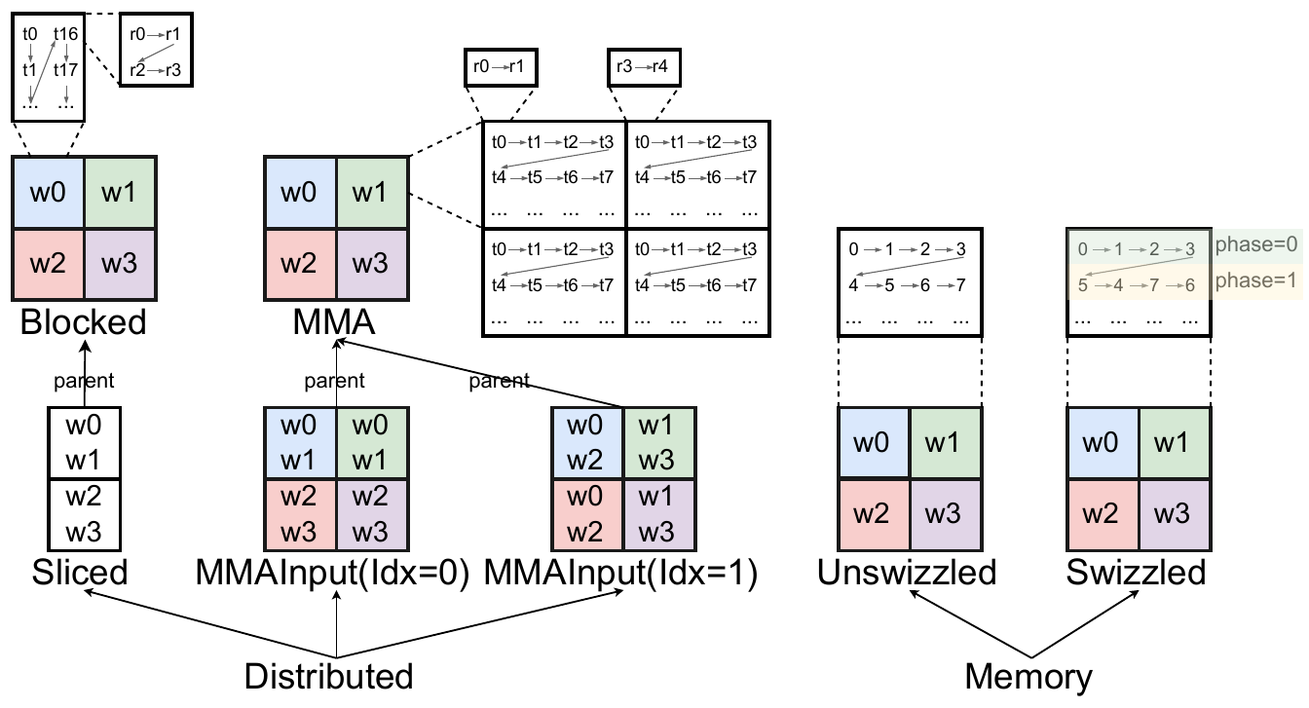
Legacy Triton layouts: two families
OVERVIEW · §3
Distributed: Reg × Thr × Wrp → (i, j)
Blocked — general tiling for contiguous access
Sliced — parent with one dim removed (reduction output, broadcast input)
MMA — output of mma / wgmma
MMA Input — operands of mma / wgmma
Memory: offset → (i, j)
Unswizzled — plain row-major offsets
Swizzled — XOR a row phase into column groups (avoids bank conflicts)
Figure 3. Legacy layouts in Triton (wᵢ warp, tⱼ thread, rₖ register).
Source: §3 Overview and Figure 3, p. 135
Notes:
[~1:00]
Figure 3 is the taxonomy of legacy layouts in Triton — it is a classification, not a runtime pipeline.
Distributed layouts say how tensor elements are distributed across execution units: they map register, thread and warp to logical coordinates. Blocked is the general tiling layout used for contiguous memory access. Sliced is derived from a parent layout by removing one dimension — the input to a broadcast or the output of a reduction such as tt.sum. MMA layouts are the outputs of matrix-multiply instructions; MMA Input layouts are their operands, with an operand index 0 or 1.
Memory layouts map a memory offset to a logical coordinate. Unswizzled is plain row-major storage. Swizzled XORs the column-group index with a row-dependent phase, to avoid shared-memory bank conflicts; notice the phase=0 and phase=1 rows in the figure.
Each of these was its own class in the legacy code, with its own indexing and conversion code. Section 4 shows that all of them become linear layouts.

Slide 10
Linear Layouts: the mathematics
§4
The paper’s Layout A as a binary matrix → four operations on layouts and why they matter → what the propositions and theorems guarantee.
Notes:
[~0:15] Section 4. I will use the paper's Layout A from Figure 1 to show what a linear layout is and how its matrix is built, step by step. Then the four operations the paper defines — what they mean and why they matter — and finally what the propositions and theorems guarantee.

Slide 11
What is a Linear Layout?
§4.2 · DEFINITION 4.1
Definition 4.1. A Linear Layout is a linear map between labelled vector spaces over F₂.
Layout P
Reg
Thr
r₀
t₀
t₁
t₀
t₁
t₂
t₃
L : Reg × Thr × Wrp → F₂ⁿ × F₂ᵐ
y = A x (over F₂)
e₀
1
0
0
0
1
2
3
4
5
6
7
e₁
0
1
0
thread → [r₀, r₁] holds elements
e₂
0
0
1
columns: r₀ → +1, t₀ → +2, t₁ → +4
“Given a hardware location, which logical tensor element does it hold?”
Layout Q
Input = hardware index bits (Reg, Thr, Wrp); output = coordinate bits.
A function: each location holds one element — many-to-one is allowed (duplicates).
Column k = L(eₖ): the element held when only hardware bit k is set.
In words: a binary matrix multiplied with XOR and AND.
Reg
Thr
r₀
t₀
t₁
t₀
t₁
t₂
t₃
e₀
0
1
0
0
4
1
5
2
6
3
7
e₁
0
0
1
thread → [r₀, r₁] holds elements
e₂
1
0
0
columns: r₀ → +4, t₀ → +1, t₁ → +2
Illustrative example — not the paper’s exact kernel layout
Source: Definition 4.1, p. 136; column (basis) view as in LinearLayout.h; “binary matrix with XOR and AND” — GPU MODE lecture on linear layouts
Notes:
[~1:15]
Definition 4.1: a linear layout is a linear map between labelled vector spaces over F2.
For a distributed layout the input is the hardware index — register, thread and warp bits, Reg × Thr × Wrp — and the output is the bits of the tensor coordinate. So the layout answers: given a hardware location, which element does it hold? The GPU MODE lecture says it simply: a binary matrix multiplied with XOR and AND. It is a function, but it may be many-to-one: duplicated data shows up as zero columns.
A tiny illustration on the right: 8 elements, 4 threads with 2 registers each. Layout P is the identity: r0 points to element +1, t0 to +2, t1 to +4, so thread 0 holds 0 and 1. Layout Q uses the same hardware with another matrix: r0 to +4, t0 to +1, t1 to +2, so thread 0 holds 0 and 4.
Column k is where hardware bit k lands — Triton's code stores exactly these columns, the bases. P and Q come back in Section 5.4 as the source and destination of Figure 4.

Slide 12
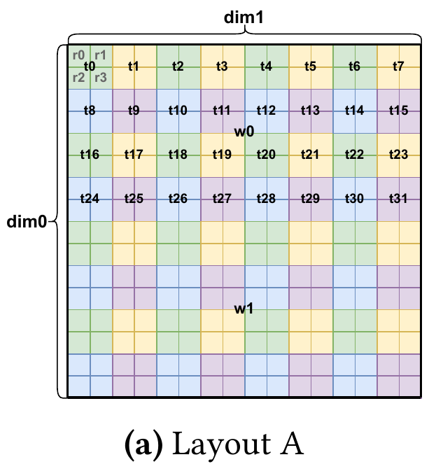
Layout A in bits: 16×16 tensor, 2 warps
§4.1 · MOTIVATING EXAMPLE
Dimension | Size | Bits | Names
Tensor rows i | 16 | 4 | i₀ i₁ i₂ i₃
Tensor cols j (fastest) | 16 | 4 | j₀ j₁ j₂ j₃
Registers / thread | 2×2 = 4 | 2 | q₀ q₁
Threads / warp | 4×8 = 32 | 5 | t₀ … t₄
Warps / CTA | 2×1 = 2 | 1 | w
Table 1 (excerpt)
(i, j) | Reg | Thr | Wrp
(0,0) | r₀ 0b0 | t₀ | w₀
(0,1) | r₁ 0b1 | t₀ | w₀
(0,2) | r₀ 0b0 | t₁ | w₀
(1,0) | r₂ 0b10 | t₀ | w₀
(1,1) | r₃ 0b11 | t₀ | w₀
(2,2) | r₀ 0b0 | t₉ 0b1001 | w₀
(2,3) | r₁ 0b1 | t₉ 0b1001 | w₀
(3,3) | r₃ 0b11 | t₉ 0b1001 | w₀
Input: 2 + 5 + 1 = 8 hardware bits. Output: 4 + 4 = 8 coordinate bits → A is an 8×8 matrix over F₂.
Every r₀ sits where the last bits of i and j are 0; r₁ flips j₀; r₂ flips i₀.
Bit vectors are LSB-first; j (fastest) bits come before i bits in y.
Figure 1(a): Layout A
Where does a layout come from? Triton picks it: loads/stores get a Blocked layout ordered by memory contiguity (up to 128 bits per thread: fp32 → 4, fp16 → 8); tt.dot gets an MMA layout chosen by GPU generation and data type; reductions give Sliced layouts; the layout engine (§4.4) propagates the rest.
Source: §4.1, Figure 1(a) and Table 1, p. 136; Coalesce and AccelerateMatmul passes (upstream Triton)
Notes:
[~1:30]
Back to Layout A from Figure 1. Almost everything on a GPU is a power of two, and Triton restricts tensor and layout sizes to powers of two, so every index is a bit vector.
The tensor is 16 by 16: 4 bits for the row i and 4 for the column j — 8 output bits. On the hardware side: each thread holds a 2 by 2 tile, so 4 registers — 2 register bits, which I call q0 and q1 to keep them apart from register numbers r0 to r3. Each warp has 32 threads arranged 4 by 8 — 5 thread bits. Two warps stacked vertically — 1 warp bit. 8 bits in, 8 bits out: an 8 by 8 binary matrix.
Table 1 lists some elements in binary. Every r0 sits where the last bits of i and j are 0; r1 flips the last bit of j; r2 flips the last bit of i. Each register bit flips exactly one coordinate bit — that is the whole idea.
Where does such a layout come from? Triton picks it: loads and stores get a blocked layout ordered by memory contiguity, up to 128 bits per thread; tt.dot gets an MMA layout chosen by GPU generation and data type; reductions produce sliced layouts; the layout engine propagates the rest.

Slide 13
Building the 8×8 matrix A column by column
§4.1 · THE PAPER’S MATRIX
Reg
Thr
Wrp
Read each column = where that hardware bit points
q₀
q₁
t₀
t₁
t₂
t₃
t₄
w
j
j₀
1
0
0
0
0
0
0
0
q₀ → j₀
register bit 0: one column right in the 2×2 tile
j₁
0
0
1
0
0
0
0
0
q₁ → i₀
register bit 1: one row down in the tile
j₂
0
0
0
1
0
0
0
0
t₀ t₁ t₂ → j₁ j₂ j₃
8 threads across: steps of 2, 4, 8 columns
j₃
0
0
0
0
1
0
0
0
i
i₀
0
1
0
0
0
0
0
0
t₃ t₄ → i₁ i₂
4 thread-rows down: steps of 2, 4 rows
i₁
0
0
0
0
0
1
0
0
w → i₃
warp 1 sits 8 rows below warp 0
i₂
0
0
0
0
0
0
1
0
Exactly one 1 in every column and every row → A is a permutation matrix (under this bit ordering).
i₃
0
0
0
0
0
0
0
1
A (8×8 over F₂)
Paper’s exact matrix
Source: Matrix A in §4.1, p. 136
Notes:
[~1:00]
Here is the paper's exact matrix A. Columns are the input bits q0, q1 | t0..t4 | w; rows are the output bits j0..j3, then i0..i3.
Read one column at a time: if only this hardware bit is 1, which coordinate do I get?
- q0 → j0: one column right inside the 2 by 2 tile. q1 → i0: one row down.
- t0, t1, t2 → j1, j2, j3: the 8 threads along a row step across tiles of width 2 — worth 2, 4 and 8 columns.
- t3, t4 → i1, i2: the 4 thread-rows step down by 2 and 4 rows.
- w → i3: warp 1 is 8 rows below warp 0.
Exactly one 1 in every column and every row: under this bit ordering A is a permutation matrix, the typical shape of a blocked layout. This is the paper's chosen example; the compiler picks a layout from the operations and the target, so it is not a universal default.

Slide 14
Trace: register r₁ of thread t₉ in warp w₀
§4.1 · WORKED EXAMPLE
Reg
Thr
Wrp
① Encode hardware location (LSB first)
q₀
q₁
t₀
t₁
t₂
t₃
t₄
w
r₁ = 0b01 → [q₀,q₁] = [1,0]
t₉ = 0b01001 → [t₀…t₄] = [1,0,0,1,0]
w₀ = 0 → [w] = [0]
x = [1,0 | 1,0,0,1,0 | 0]ᵀ
j
j₀
1
0
0
0
0
0
0
0
1
1
j₁
0
0
1
0
0
0
0
0
0
1
j₂
0
0
0
1
0
0
0
0
1
0
j₃
0
0
0
0
1
0
0
0
0
0
×
=
i
i₀
0
1
0
0
0
0
0
0
0
0
② Multiply = XOR the highlighted columns
i₁
0
0
0
0
0
1
0
0
1
1
y = col(q₀) ⊕ col(t₀) ⊕ col(t₃) → rows j₀, j₁, i₁ set
i₂
0
0
0
0
0
0
1
0
0
0
i₃
0
0
0
0
0
0
0
1
0
0
③ Decode output bits
[j₀…j₃] = [1,1,0,0] = 0b0011 → j = 3
[i₀…i₃] = [0,1,0,0] = 0b0010 → i = 2
L(r₁, t₉, w₀) = (i, j) = (2, 3) ✓ Table 1
A
x
y
Paper’s example
Source: §4.1 and Table 1, p. 136
Notes:
[~1:00]
This is the paper's own worked example, and the best check that the matrix is understood.
Step 1, encode the hardware location in bits, least-significant bit first. Register 1 is 0b01, so [q0, q1] = [1, 0]. Thread 9 is binary 01001, so LSB-first [t0..t4] = [1, 0, 0, 1, 0]. Warp 0 gives w = 0. Stack them: x = [1,0 | 1,0,0,1,0 | 0].
Step 2, multiply. In the column view, y is the XOR of the highlighted columns — the columns where x has a 1: q0, t0 and t3. q0 contributes j0, t0 contributes j1, t3 contributes i1.
Step 3, decode. The j bits [j0..j3] = [1,1,0,0] = 0b0011 = 3. The i bits [i0..i3] = [0,1,0,0] = 0b0010 = 2. So L(r1, t9, w0) = (i, j) = (2, 3), which matches the row "(2,3) → r1, t9, w0" of Table 1.
Watch the ordering: the bit lists are LSB-first, and y lists j bits before i bits, but the coordinate is written (i, j).

Slide 15
Columns = hierarchical offsets: loc_reg ⊕ loc_thr ⊕ loc_warp
§4.1 · COLUMN VIEW
Paper’s example: r₁, t₉, w₀
Practice: r₃, t₁₄, w₁
r₃ = 0b11 → q₀ = q₁ = 1; t₁₄ = 0b01110 → t₁, t₂, t₃ = 1; w = 1
j₀
1
0
0
1
active bit | column of A (j₀..j₃ | i₀..i₃) | i | j
q₀ | 1000 | 0000 | 0 | 1
q₁ | 0000 | 1000 | 1 | 0
t₁ | 0010 | 0000 | 0 | 4
t₂ | 0001 | 0000 | 0 | 8
t₃ | 0000 | 0100 | 2 | 0
w | 0000 | 0001 | 8 | 0
XOR | 1011 | 1101 | 11 | 13
j₁
0
1
0
1
j₂
0
0
0
0
j₃
0
⊕
0
⊕
0
=
0
i₀
0
0
0
0
i₁
0
1
0
1
i₂
0
0
0
0
i₃
0
0
0
0
loc_r₁
loc_t₉
loc_w₀
y
Check with Figure 1: t₁₄ is thread-row 1, thread-col 6 → rows 2–3, cols 12–13; warp 1 adds 8 rows; r₃ = bottom-right → (11, 13) ✓
(0, 1)
(2, 2)
(0, 0)
(2, 3)
Bits never overlap here, so XOR = +. The matrix is the hierarchy written in one place.
Source: §4.1 (register → loc_thread, thread → loc_warp, warp → loc), p. 136
Notes:
[~1:00]
The paper explains the same computation hierarchically: each hardware level contributes an offset inside an ever larger tile, and we XOR them.
For r1 in t9 in w0: the register puts the element at (0, 1) inside the thread's tile; thread 9's tile sits at (2, 2) inside the warp tile; warp 0 sits at (0, 0). XOR gives (2, 3) — the same answer, because these offsets are just the columns of A grouped by level.
To practise: r3, t14, w1. The active bits are q0, q1, t1, t2, t3 and w. XOR the i parts: 1 ⊕ 2 ⊕ 8 = 11; the j parts: 1 ⊕ 4 ⊕ 8 = 13. So (11, 13). Check with the picture: thread 14's tile covers rows 2–3 and columns 12–13, warp 1 adds 8 rows, and register 3 is the bottom-right corner. Because the bits never overlap, XOR equals addition here.

Slide 16
Composition: apply one layout after another
§4.2 · DEFINITION 4.2
Definition 4.2. For L₁ : U → V and L₂ : V → W, L₂ ∘ L₁ : U → W, u ↦ L₂(L₁(u)). As matrices: the (label-wise) product M₂ M₁ over F₂.
L₁ (matrix M₁)
L₂ (matrix M₂)
U
V
W
L₂ ∘ L₁ ↔ M₂ · M₁ (one product, computed at compile time)
Key idea
Composition chains two layouts into one: the matrix of L₂ ∘ L₁ is simply the product M₂ M₁ over F₂.
Composition and product combine simple layouts into complex ones — e.g. composition extracts a slice by mapping a parent dimension to all zeros.
Source: Definition 4.2 and text, pp. 136–137; used in §4.4, §5.3 and §5.4
Notes:
[~0:15]
Definition 4.2: composing two layouts, L2 after L1, is just the matrix product M2 times M1 over F2. Composition and product are how the paper combines simple layouts into more complex ones — for example, composition extracts a slice from a parent layout by mapping one of its dimensions to all zeros.

Slide 17
Product: build a layout level by level
§4.2 · DEFINITION 4.3
Definition 4.3. For L₁ : U₁ → V₁ and L₂ : U₂ → V₂, L₁ × L₂ : (u₁, u₂) ↦ (L₁(u₁), L₂(u₂)). As matrices: block diagonal [ M₁ 0 ; 0 M₂ ].
M₁
0
L_Reg
0
0
L₁ × L₂ ↔
blocked layout = L_Reg × L_Thr × L_Wrp ↔
0
L_Thr
0
0
M₂
0
0
L_Wrp
zero blocks = the parts do not interact
Key idea
Independent layouts can be merged into a single layout: each part acts only on its own bits, so the matrix is block diagonal.
Bigger layouts are built incrementally — registers × threads × warps — exactly how matrix A is formed.
Source: Definition 4.3, footnote 2 and text, pp. 136–137; Proposition 4.6; BlockedEncodingAttr::toLinearLayout (upstream Triton)
Notes:
[~0:15]
Definition 4.3: the product of two layouts acts on each part separately, so its matrix is block diagonal. This means we can merge independent layouts into a single layout. And it lets us build bigger layouts incrementally — registers, then threads, then warps — which is exactly how matrix A is formed.

Slide 18
Left division: split off a block that one instruction handles
§4.2 · DEFINITION 4.4
Definition 4.4. M is divisible on the left by M₁ if M = [ M₁ 0 ; 0 M₂ ]. Then M /ℓ M₁ = M₂ (handled label-wise).
M₁
0
M₁
≠0
/ℓ M₁ =
M₂
0
M₂
0
M₂
✓ M₁ is an independent block → divisible
✗ block linked to the rest → not divisible
Key idea
Left division is the inverse of the product (when it exists): it splits off an independent block M₁ and leaves M₂.
It decides whether a layout can be decomposed into pieces that match efficient hardware primitives, such as ldmatrix (Theorem 5.1).
Source: Definition 4.4 and text, p. 137; Theorem 5.1 (§5.3)
Notes:
[~0:15]
Definition 4.4: left division is the inverse operation of the product, when it exists — it splits off an independent block M1 and leaves M2. The paper uses it to determine whether a layout can be decomposed into smaller layouts that match efficient hardware primitives such as ldmatrix; that is Theorem 5.1 in Section 5.3.

Slide 19
Right inverse: from a tensor element back to a hardware location
§4.2 · DEFINITION 4.5
Definition 4.5. A surjective L : U → V has a right inverse. For its m × n matrix M, M⁻¹ is the n × m least-squares solution of M X = Iₘ, computed by Gaussian elimination over F₂.
X
M (m × n)
·
=
Iₘ
Duplicated data (zero columns) → several valid choices → free (slack) variables, set to 0 in §5.4.
layout: hardware → tensor
M⁻¹ (n × m): tensor → hardware
Key idea
Every surjective layout has a right inverse, computed by Gaussian elimination over F₂.
It is used to recover hardware indices from coordinates in the logical tensor.
Source: Definition 4.5, p. 137; used in §5.1, §5.4 and §5.5
Notes:
[~0:15]
Definition 4.5: every surjective layout has a right inverse, computed by Gaussian elimination over F2. The paper uses it whenever it needs to recover hardware indices from coordinates in the logical tensor.

Slide 20
Completeness: every Triton layout is a linear layout
§4.3 · PROPOSITIONS 4.6–4.8, THEOREMS 4.9 AND 4.13
Distributed layouts (registers, threads, warps)
What this means
Prop 4.6: blocked layouts are linear — a product of identities (like matrix A).
Prop 4.7: the input and output layouts of mma / wgmma are linear (AMD and Intel matrix instructions likewise).
Prop 4.8: a slice of a linear layout is linear — removing a dimension deletes rows.
Thm 4.9: therefore every distributed layout is a linear layout.
One representation covers every layout Triton uses — no extra layout classes needed.
The §5 algorithms are written once, on the matrices, and work for every layout (GPU MODE: this fixed most earlier layout bugs).
The proofs are constructive: each layout class gets a routine that writes down its matrix.
Memory layouts (shared memory)
Thm 4.13: every memory layout — unswizzled or swizzled — is a linear layout.
Source: §4.3, pp. 137–138; LinearLayoutConversions.cpp (upstream Triton); GPU MODE lecture on linear layouts
Notes:
[~1:15]
Section 4.3 answers one question: can every layout Triton uses be written as a linear layout? Yes.
For distributed layouts — registers, threads and warps — there are three propositions. Proposition 4.6: blocked layouts are linear; they are products of identities, exactly like matrix A. Proposition 4.7: the input and output layouts of the mma and wgmma instructions are linear, and the paper notes that AMD's and Intel's matrix instructions work the same way. Proposition 4.8: a slice of a linear layout is linear — removing a dimension just deletes rows. Together they give Theorem 4.9: every distributed layout is a linear layout. For shared memory, Theorem 4.13: every memory layout, unswizzled or swizzled, is a linear layout too.
What this means: one representation covers everything Triton uses; no extra layout classes are needed. The algorithms of Section 5 are written once, on the matrices, and work for every layout — the GPU MODE lecture says this fixed the source of most earlier layout bugs. The proofs are constructive: for each legacy layout class there is a routine that writes down its matrix.

Slide 21
Closure: shape operations move no data
§4.4 · CLOSURE UNDER TRITON OPERATIONS
Triton has four kinds of operations: computation, memory, layout conversion and shape operations. A shape operation never changes a value — it only renames coordinate bits, so there is always an output layout that makes it a no-op (the paper proves this closure).
Each shape operation only relabels bits
Example: transpose a tensor in layout A
Shape operation | Effect on the layout matrix | Data moved
tl.trans / tl.permute | reorder the coordinate rows | none
tl.reshape | regroup coordinate bits | none
tl.expand_dims | add a size-1 dim (no bits) | none
tl.broadcast_to | fill zero columns (reverse of slicing) | none
tl.join / tl.split | add / remove one bit (a register bit) | none
xt = tl.trans(x) # x: [16, 16] in layout A
Reg
Thr
Wrp
q₀
q₁
t₀
t₁
t₂
t₃
t₄
w
j′
i₀
0
1
0
0
0
0
0
0
Layout of xt = the rows of A, relabelled: A’s i rows become j′, its j rows become i′.
i₁
0
0
0
0
0
1
0
0
i₂
0
0
0
0
0
0
1
0
i₃
0
0
0
0
0
0
0
1
i′
j₀
1
0
0
0
0
0
0
0
r₁ of t₉ in w₀ held x[2, 3] → the same register now holds xt[3, 2]. No data moves.
Layout engine (compile time): anchor layouts — blocked for global loads/stores, MMA for tt.dot — are propagated forward and backward; conversions only where layouts conflict.
Why it matters: layouts flow through shape ops for free. Legacy layouts could not even represent the transpose of an MMA layout → extra conversions.
j₁
0
0
1
0
0
0
0
0
j₂
0
0
0
1
0
0
0
0
j₃
0
0
0
0
1
0
0
0
Source: §4.4, p. 138; transpose example uses the paper’s Layout A (§4.1)
Notes:
[~1:30]
Section 4.4. Triton's operations fall into four groups: computation, memory, layout conversion, and shape operations — trans, reshape, join, split, expand_dims and broadcast. A shape operation never changes a value; it only changes which coordinate bits are which. So for every input layout there is an output layout of the same family for which the operation is a no-op — nothing moves, and no instruction is emitted. The paper proves this closure for distributed layouts, forward and backward.
The example on the right: transpose x, which has layout A. Register r1 of thread 9 in warp 0 held x[2, 3]; after the transpose the very same register holds xt[3, 2]. The matrix of xt is the matrix of A with its rows relabelled — the i rows of A become the j-prime rows of xt, and the j rows become the i-prime rows. The table on the left shows the same idea for the other operations: reshape regroups the bits, expand_dims adds a dimension with no bits, broadcast fills zero columns, join and split add or remove one bit.
Why this matters: Triton's layout engine gives anchor layouts — blocked layouts for global loads and stores, and the MMA layouts tt.dot needs — then propagates them forward and backward through the program, inserting conversions only where layouts conflict. Closure lets layouts flow through every shape operation for free. Legacy layouts could not even represent the transpose of an MMA layout, so the engine had to insert real conversions — extra data movement. With linear layouts the engine stays generic.

Slide 22
Code generation with linear layouts
§5
Yes — §5 applies the §4 tools (composition, inverses, left division, zero columns, subspaces) at compile time, while lowering TTGIR to LLVM, to decide which instructions to emit.
Notes:
[~0:30]
Section 5. A natural question: is this where we take the concepts from Section 4 and use them to generate backend code? Yes. During compilation, when Triton lowers TritonGPU IR to LLVM, every tensor has a layout matrix. Each code-generation decision — how wide a load can be, who must store a duplicated value, which shared-memory instruction to use, how to move data between two layouts — becomes a question about those matrices, answered with the operations we just saw. The answers decide which instructions are emitted; nothing is solved at run time.

Slide 23
Every code-generation question becomes a matrix question
§5 · OVERVIEW
§ | Compiler question | §4 tool that answers it
5.1 | How wide can each thread’s load/store be? | right inverse of the register part (identity prefix)
5.1 | Which threads hold duplicated data? | product → zero columns
5.2 | Where do MXFP4 scales go? How to load an operand wide? | shape ops = composition; closure (§4.4)
5.3 | Which st.shared / ldmatrix / stmatrix fits? | L = A⁻¹ ∘ B, then left division by the instruction tile
5.4 | How to move data from layout A to layout B cheaply? | B⁻¹ ∘ A, right inverse, subspaces → warp shuffles
5.4 | Which shared layout gives wide, conflict-free access? | subspace construction of a memory layout M
Source: §5.1–§5.4, pp. 138–141
Notes:
[~0:30]
This table is the map of Section 5: the question the compiler must answer, and the tool from Section 4 that answers it.
For 5.1 and 5.2 I show a small example each. For 5.3 this table is enough: a shared-memory instruction can be used when its tile divides the layout — Theorem 5.1, the left division from Section 4. For 5.4 — layout conversion with warp shuffles, and optimal swizzling — I use the paper's Figures 4 and 5 to show the idea and the result.

Slide 24
Contiguous elements: how wide can each load and store be?
§5.1 · LAYOUT UTILITIES
x = tl.load(ptr + offs) # x: [512, 2] fp8, row-major — how many bytes can each load instruction move?
Legacy Triton: the problem
Linear layouts: the approach
Vector width = how many contiguous elements a thread owns.
Heuristic used only the fastest dimension → misses runs that span several dimensions.
Map the register block to memory offsets and invert it (right inverse).
Largest u with L_Reg⁻¹(k) = k for k < u → u contiguous elements (capped at 128 bits).
Example (illustrative): x[512, 2] fp8, each thread holds 8 rows × 2 columns = 16 elements
thread 0’s elements in memory (offset = 2i + j)
L_Reg: register bits → memory offset bits
0
1
2
3
4
5
6
7
8
9
10
11
12
13
14
15
r₀ → +1 (next column) · r₁ r₂ r₃ → +2, +4, +8 (next rows)
r₀
r₁
r₂
r₃
row 0
row 1
row 2
row 3
row 4
row 5
row 6
row 7
o₀
1
0
0
0
Legacy: fastest dim has 2 elements → 2 × 8 bit = 16 bits → 8 × ld.v1.b16
o₁
0
1
0
0
identity on 4 bits → u = 2⁴ = 16 contiguous
Linear layouts: 16 contiguous → 16 × 8 bit = 128 bits → 1 × ld.v4.b32
o₂
0
0
1
0
o₃
0
0
0
1
Source: §5.1 “Contiguous elements”, p. 138; Table 3 and “Load/Store Contiguity”, p. 142
Notes:
[~1:15]
The first layout utility: how many contiguous elements does each thread own? That decides the width of each vectorized load or store. Legacy Triton guessed it from the fastest-running dimension, which fails when the contiguous elements span several dimensions.
The example: a row-major [512, 2] fp8 tensor, where each thread holds 8 rows by 2 columns — 16 elements. In memory, element (i, j) is at offset 2i + j, so the thread's 16 elements are offsets 0 to 15, one contiguous run. Legacy Triton looks only at the last dimension, which has 2 elements: 2 × 8 bits = 16 bits per access, so 8 narrow loads.
With linear layouts we look at the register part of the layout, mapped to memory offsets. Register bit r0 moves one column, +1; r1, r2, r3 move one, two, four rows, +2, +4, +8. That matrix is the identity on 4 bits, so the inverse maps element k to register k for all k below 16: u = 16. 16 × 8 bits = 128 bits — one v4.b32 load.
This is exactly the [512, 2] fp8 row of Table 3: v1.b16 becomes v4.b32.

Slide 25
Broadcasting: which threads hold the same value?
§5.1 · LAYOUT UTILITIES
x = tl.load(ptr + tl.arange(0, 16)) # 16 elements, one warp of 32 threads (num_warps = 1)
s = tl.sum(x, axis=0); tl.store(out_ptr + tl.arange(0, 16), x)
Legacy Triton: the problem
Linear layouts: the approach
Tile larger than the tensor → several threads/warps hold duplicates.
Reductions must not count copies twice; stores should not repeat them — found per layout → bug source.
Tiling = product; duplicates = zero columns (“don’t-care” hardware bits).
Mask those bits when reducing or storing — the same rule for every layout.
Example (illustrative): 16 elements held by 32 threads, one register each
element held by each thread
thread bits → element bits
0
1
2
3
4
5
6
7
8
9
10
11
12
13
14
15
t0 … t15
t₀
t₁
t₂
t₃
t₄
e₀
1
0
0
0
0
0
1
2
3
4
5
6
7
8
9
10
11
12
13
14
15
t16 … t31
e₁
0
1
0
0
0
e₂
0
0
1
0
0
Reduce: combine over t₀…t₃ only — using t₄ would count every element twice.
e₃
0
0
0
1
0
Store: only threads with t₄ = 0 write → 16 stores instead of 32.
t₄ = zero column → duplicate
Source: §5.1 “Broadcasting”, pp. 138–139; Table 4, p. 142
Notes:
[~1:15]
The second utility: duplicated data. A legacy layout is defined by a tile spread over registers, threads and warps. If the tile is larger than the tensor, the tensor is replicated, so several threads hold the same element. Reductions and scans must not count those copies twice, and stores should not write them twice. Working this out per layout was a persistent source of Triton bugs.
The example: a 16-element tensor loaded by one warp of 32 threads, one element per thread. Threads t and t + 16 hold the same element. As a matrix, the thread bits t0 to t3 map to the element bits, and t4 is a zero column: flipping t4 does not change the element. That zero column is the whole answer. When reducing, combine only over t0 to t3, because including t4 would add every element twice. When storing, only threads with t4 = 0 write: 16 stores instead of 32.
With linear layouts tiling is just a product and duplicates are always zero columns, for any layout. Table 4: reductions now pass on every tested layout, with up to 76% fewer shared-memory stores.

Slide 26
Mixed precision: MXFP4 × bf16 with shape operations
§5.2 · MIXED-PRECISION MATMUL
acc = tl.dot_scaled(a, a_scale, "e2m1", b, None, "bf16") # a: MXFP4 (4-bit + 8-bit scale per 32 values), b: bf16
Setting: a is MXFP4 — 4-bit values, every 32 share one 8-bit scale; b is bf16. Linear layouts solve two problems here, both with shape operations.
① Software emulation (no native MXFP4)
Example (illustrative): one row, K = 16, four threads
Upcast mxfp4 → bf16, then a normal bf16 MMA. The 8 threads of one MMA row share one scale.
Legacy: a new layout + conversions to all others. Linear layouts: write the broadcast with reshape / trans / broadcast — the engine finds the scales’ layout.
MMA: thread t uses k = 2t, 2t+1, 2t+8, 2t+9
t0
t1
t2
t3
Before: the mxfp4 row in memory (colour = thread that needs it)
0
1
2
3
4
5
6
7
8
9
10
11
12
13
14
15
t0 needs 0, 1 and 8, 9 → two pieces → narrow loads
② Data shuffling (wide mxfp4 loads)
After shuffling bf16’s K once: thread t loads 4t … 4t+3
The MMA gives each thread two separate pieces of a row → no wide mxfp4 load.
Shuffle bf16 once in HBM → each thread’s mxfp4 values become contiguous. ≈ 5 lines of Python (Machete: thousands of lines + CUTLASS).
0
1
2
3
4
5
6
7
8
9
10
11
12
13
14
15
t0 loads 0–3 → one contiguous, wide load
Why the result is unchanged: a · b = Σₖ aₖ bₖ, and a sum does not depend on its order. bf16 gets the same reordering, so every aₖ still meets its bₖ.
Result (Figure 6): up to 1.87× on GH200.
Source: §5.2 “Software Emulation”, “Data Shuffling” and footnote 3, p. 139; Figure 6, p. 143; mma.m16n8k16 operand fragment (PTX ISA)
Notes:
[~1:45]
Section 5.2, mixed-precision matrix multiplication. The setting: a times b, where a is MXFP4 — 4-bit values, where every 32 values share one 8-bit scale — and b is bf16. Linear layouts help in two ways.
First, software emulation. GPUs before B200 and MI350 have no native MXFP4 instructions, so a is upcast to bf16 and multiplied with a normal bf16 MMA. Each scale must reach the right threads: in the MMA layout, the 8 threads of one row share one scale. With legacy layouts this needed a new layout class plus conversions to every other layout. With linear layouts the scale broadcast is written with ordinary shape operations — reshape, transpose, broadcast — and the layout engine works out the layout for loading the scales by itself.
Second, data shuffling — the example on the right. The tensor-core instruction fixes which k values each thread holds: in one row, thread t uses k = 2t, 2t + 1 and 2t + 8, 2t + 9. So thread 0 needs elements 0, 1 and 8, 9 of the mxfp4 row — two separate pieces, so it cannot use one wide load. The fix: a dot product is a sum over k, and the order of a sum does not matter. So the bf16 operand is shuffled once in HBM, and the mxfp4 data is used in the matching order. Now thread t simply loads four neighbours, 4t to 4t + 3 — one wide load — and every a_k still meets its own b_k, so the result is unchanged. Machete needed several thousand lines and CUTLASS for this; with linear layouts it is about five lines of Python with shape operations.
Result, Figure 6: up to 1.87 times on GH200.

Slide 27
Layout conversion: move data from layout A to layout B cheaply
§5.4 · LAYOUT CONVERSION (1/3)
Example (Triton): where a conversion appears
acc = tl.dot(a, b) # result lives in the MMA layout (A)
tl.store(c_ptrs, acc) # a coalesced store wants a blocked layout (B) → compiler inserts convert_layout
Source location x holds A(x). We need y with B(y) = A(x) ⇒ y = (B⁻¹ ∘ A)(x) (B⁻¹ = right inverse; legacy Triton always went through shared memory).
Registers only
Warp shuffles
Shared memory
B⁻¹∘A only permutes the register block
data crosses threads; warp block = identity
data crosses warps
→ rename registers — free
→ shuffle rounds — this algorithm
→ store + load with an optimal swizzle (next)
Choosing among right inverses: ① if A and B agree on Reg / Thr / Wrp, keep that block the identity; ② set slack variables to 0 (minimal Hamming weight) so duplicates read from one source.
Source: §5.4, p. 140; GPU MODE lecture on linear layouts (same formula for register → shared conversions)
Notes:
[~1:00]
Now the first of the two central algorithms. A layout conversion produces the same tensor in a different distributed layout. A typical place in Triton: the result of tl.dot lives in the MMA layout, but a coalesced tl.store wants a blocked layout, so the layout engine inserts a convert_layout between them.
Legacy Triton always went through shared memory: write, barrier, read. Correct, but slow, and it uses shared memory.
With linear layouts the conversion is a composition: location x holds A(x); we need y with B(y) = A(x), so y = B inverse of A of x, using a right inverse of B. The GPU MODE lecture writes the same formula.
The blocks of B inverse A decide the mechanism. Only registers change: rename registers, free. Data crosses threads but not warps: warp shuffles. Data crosses warps: shared memory, with the optimal swizzle. To choose among right inverses: keep blocks where A and B agree as the identity, and set slack variables to zero so duplicates read from one source.

Slide 28
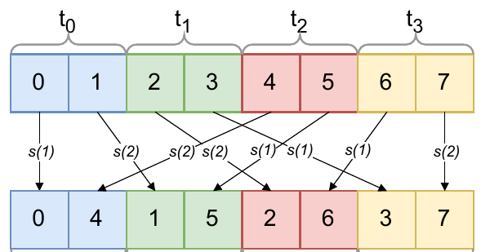
Figure 4 example: compute the conversion map B⁻¹ ∘ A
§5.4 · LAYOUT CONVERSION (2/3)
Reg
Thr
Reg
Thr
r
t₀
t₁
r
t₀
t₁
e₀
1
0
0
e₀
0
1
0
e₁
0
1
0
e₁
0
0
1
e₂
0
0
1
e₂
1
0
0
A
B
Reg
Thr
r
t₀
t₁
source bit | goes to
register r (+1) | thread t₀′
thread t₀ (+2) | thread t₁′
thread t₁ (+4) | register r′
Figure 4 (left). Top: layout A. Bottom: layout B. s(1), s(2) = shuffle rounds.
r′
0
0
1
Source A: thread t holds 2t, 2t+1 (t0: 0, 1 · t1: 2, 3 · …)
Destination B: thread t holds t, t+4 (t0: 0, 4 · t1: 1, 5 · …)
t₀′
1
0
0
t₁′
0
1
0
B⁻¹ ∘ A (B⁻¹ = Bᵀ)
Trace element 5: A → thread 2, reg 1 → x = [1, 0, 1]; y = col(r) ⊕ col(t₁) = [1, 1, 0] → thread 1, reg 1 ✓ (B: thread 1 holds 1, 5)
Decision: the register bit moves to a thread bit → data crosses threads; no warp bit changes → warp shuffles inside one warp, no shared memory.
Paper’s Figure 4
Source: §5.4 and Figure 4, p. 140 (4 threads for clarity; any power-of-two warp works the same way)
Notes:
[~1:30]
The paper's Figure 4. Eight elements held by 4 threads with 2 registers each; the paper uses 4 threads for clarity, and a full warp works the same way.
Source layout A, the top row: thread t holds 2t and 2t + 1. As a matrix over the element bits e0, e1, e2, the register bit points to +1 and the thread bits to +2 and +4 — the identity. Destination layout B, the bottom row: thread t holds t and t + 4: register bit +4, thread bits +1 and +2.
Now the conversion map, using the formula from the previous slide. B is a permutation, so its inverse is its transpose; multiply by A. Read the columns of the result: the source register bit goes to destination thread bit t0'; source thread bit t0 goes to t1'; source thread bit t1 goes to the destination register.
Trace element 5: in A it is thread 2, register 1, so x = [1, 0, 1]. XOR the columns for r and t1: [1, 1, 0] — destination thread 1, register 1. B agrees: thread 1 holds 1 and 5.
The decision for the compiler: the register bit moves to a thread bit, so data must cross threads; no warp bit changes, so everything stays inside one warp. So: warp shuffles, no shared memory.

Slide 29
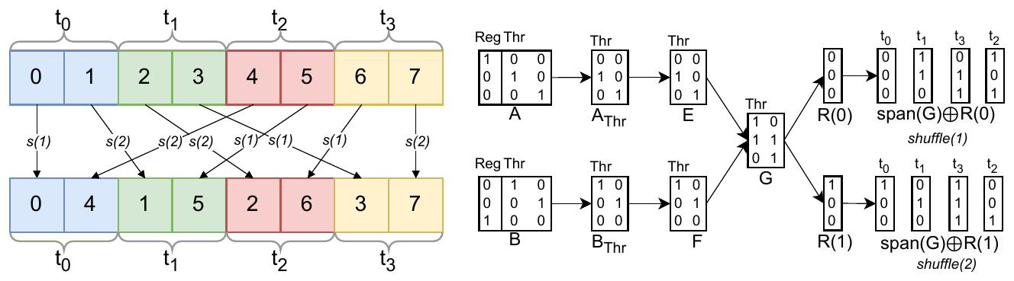
From B⁻¹ ∘ A to an optimal series of warp shuffles
§5.4 · LAYOUT CONVERSION (3/3)
Figure 4. Left: the two shuffle rounds s(1), s(2). Right: how the rounds are derived from the matrices.
The conversion runs as an optimal series of warp shuffles, found by an algorithm in the paper (§5.4) from B⁻¹ ∘ A: in every round each thread sends one value and receives one — here just 2 rounds.
Generic: one algorithm for any pair of layouts that exchange data inside a warp (it reproduces FlashAttention-3’s hand-tuned shuffles) — up to 3.93× faster than shared memory (Figure 7).
Source: §5.4 “Intra-warp Data Exchange” and Figure 4, p. 140; Figure 7, p. 143; GPU MODE lecture on linear layouts
Notes:
[~1:00]
Once we know the data stays inside one warp, the compiler turns B inverse A into the actual shuffles. The paper gives an algorithm for this in Section 5.4; I will not go through its steps, only what it produces.
Figure 4 shows the result for our example: two shuffle rounds, s1 and s2. In each round every thread sends exactly one value and receives exactly one value, so no thread is idle and no round is wasted — that is why the series is optimal.
The important point is that it is generic: the same algorithm works for any pair of layouts that exchange data inside a warp, with no hand-written case per layout. The GPU MODE lecture notes that it reproduces the hand-tuned shuffles of FlashAttention-3. In the evaluation, Figure 7, it is up to 3.93 times faster than going through shared memory.

Slide 30
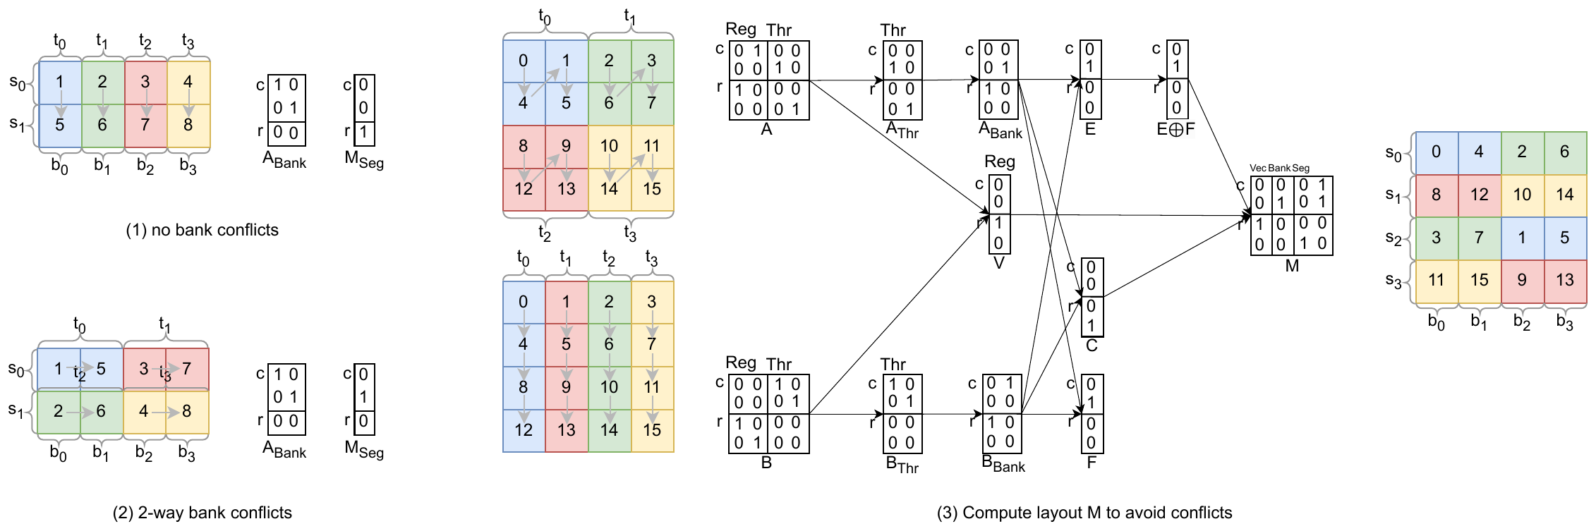
Optimal swizzling: shared-memory layouts are linear layouts too
§5.4 · OPTIMAL SWIZZLING
Figure 5. (1) no bank conflicts, (2) 2-way bank conflicts, (3) the computed swizzled layout M: writes with A and reads with B are conflict-free.
The idea
What it guarantees
Why it matters
A shared-memory layout is a linear layout (offset → element).
Swizzling = choosing that matrix — the paper constructs it.
Data both sides hold together → wide vector accesses.
Segment bits no transaction uses → no bank conflicts.
Any pair of layouts; no padding or fixed swizzle parameters.
Figure 2: fp8 transpose up to ≈1.85× over padding.
Source: §5.4 “Optimal Swizzling” and Figure 5, pp. 140–141; Figure 2, p. 133; GPU MODE lecture on linear layouts
Notes:
[~1:15]
When a conversion crosses warps, the data has to go through shared memory: written with one layout, read back with another. Shared memory is split into banks, and if two threads in one transaction hit the same bank, their accesses are serialized — a bank conflict. Panel 1 of Figure 5 has none; panel 2 has a 2-way conflict.
The key point: a shared-memory layout is itself a linear layout — from memory offset to tensor element — so choosing a swizzle means choosing that matrix. The paper constructs it directly from the two register layouts, without the algebra here: elements that both sides hold together become one vector, so accesses are wide; and the segment bits are chosen as directions that no transaction uses, so no two threads of a transaction meet in the same bank.
Panel 3 is the result for a writer with 2 by 2 blocks and a reader with columns: every write and every read moves 2-element vectors and touches four different banks.
Why it matters: maximal vectorization and minimal bank conflicts, for any pair of layouts, instead of fixed swizzle parameters or padding. The GPU MODE lecture adds that this gives optimal swizzles for transposes automatically — which is Figure 2 in the evaluation: up to about 1.85 times over the padding heuristic.

Slide 31
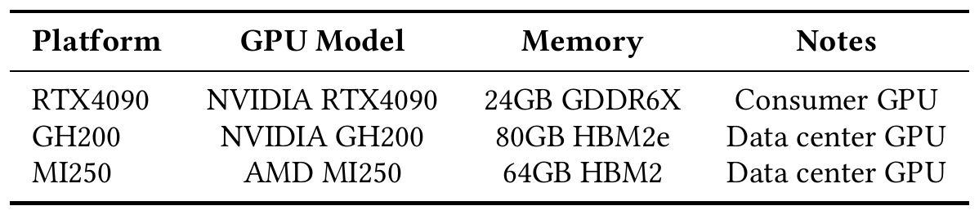
How the paper evaluates linear layouts
§6 · SETUP
Table 2. Hardware platforms evaluated.
What is compared
Micro-benchmarks (§6.1)
Real benchmarks (§6.2)
Triton-Linear (linear layouts + the §5 code generation) vs baseline Triton (legacy layouts; conversions always through shared memory).
Synthetic kernels, one operation each; 4 warps, 1 CTA (mixed-precision matmul: 4 warps per CTA, CTAs grow with input). 10 runs, median reported.
21 TritonBench kernels, 265 input cases, timed by TritonBench. Some only run on some GPUs (GH200’s shared memory, TMA).
Source: §6 introduction, “Hyperparameters” and Table 2, pp. 141–142; §6.2, p. 143
Notes:
[~1:00]
Before the results, what is compared and how.
The comparison is Triton-Linear — Triton with the linear-layout optimizations of Section 5 — against baseline Triton, which uses the legacy layouts, has none of those code-generation techniques, and always does layout conversions through shared memory.
Two kinds of experiments. First, synthetic micro-benchmarks, each isolating one operation: they run with four warps and a single CTA, except mixed-precision matmul, which uses four warps per CTA and a number of CTAs that grows with the input. Each is run 10 times and the median reported. Second, real kernels: 21 benchmarks from TritonBench, 265 input cases in total, timed by TritonBench itself.
Table 2 lists the three GPUs: an NVIDIA RTX 4090, a consumer GPU; an NVIDIA GH200, a data-centre GPU; and an AMD MI250. Not every benchmark runs on every GPU — some need the large shared memory of GH200, some use TMA descriptors that RTX 4090 and MI250 do not have.

Slide 32
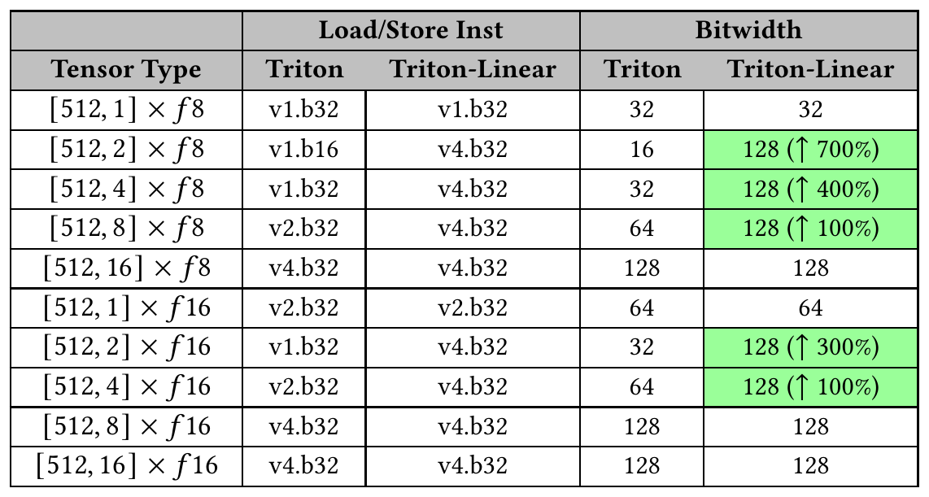
Table 3: width of each load and store
§6.1 · LOAD/STORE CONTIGUITY
What it shows
For each shape and data type: the load/store instruction each version emits and the bits moved per access.
Experiment
Synthetic kernel loading and storing [512, n] tensors (n = 1…16) in fp8 and fp16 — tests the contiguity utility of §5.1.
Key notes
When contiguous elements span both dimensions (n = 2, 4, 8), Triton-Linear reaches 128-bit accesses, e.g. [512, 2] fp8: 16 → 128 bits. The printed “↑400%” for [512, 4] fp8 (32 → 128 bits) should read +300%.
Table 3. Load/store instructions and bit widths across shapes and data types.
Source: Table 3 and “Load/Store Contiguity”, p. 142
Notes:
[~1:00]
Table 3. What it shows: for each tensor shape and data type, which load or store instruction each version emits, and how many bits one access moves.
The experiment: a synthetic kernel that loads and stores tensors of shape [512, n], with n from 1 to 16, in fp8 and fp16. It tests the contiguity utility of Section 5.1.
Key notes. When a thread's contiguous elements span both dimensions — n = 2, 4 or 8 — legacy Triton only looked at the last dimension and used narrow accesses, while Triton-Linear reaches 128-bit accesses. For example [512, 2] in fp8 goes from 16 to 128 bits. One small arithmetic note: the [512, 4] fp8 row goes from 32 to 128 bits, which is a 300% increase, but the table prints 400%; the other labels follow the "increase" convention, so it looks like a typo. And wider instructions are not the same as proportional runtime gains.

Slide 33
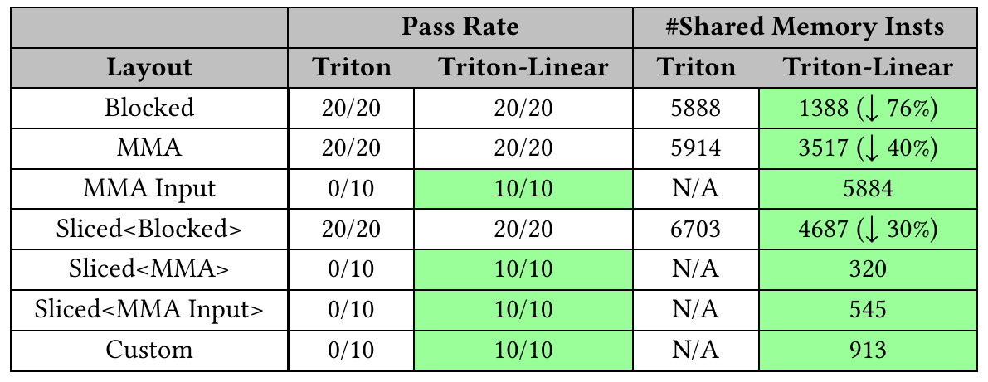
Table 4: reductions on every layout
§6.1 · BROADCASTING
What it shows
For each layout: how many reduction tests pass, and how many shared-memory instructions the code uses.
Experiment
A reduction on the most common Triton layouts, shapes [128,16], [128,128], [32,128], [32,32], [16,16] — tests the broadcasting utility of §5.1.
Key notes
Table 4. Layout support (pass rate) and number of shared-memory instructions.
Triton-Linear passes every layout (the baseline fails MMA Input, Sliced, Custom: 0/10) and uses up to 76% fewer shared-memory instructions. N/A = baseline failed.
Source: Table 4 and “Broadcasting”, p. 142
Notes:
[~0:45]
Table 4. What it shows: for each layout, how many reduction test cases pass, and how many shared-memory instructions the generated code uses.
The experiment: a reduction applied to the most common Triton layouts, on shapes [128, 16], [128, 128], [32, 128], [32, 32] and [16, 16]. It tests the broadcasting utility of Section 5.1 — knowing which threads hold duplicated data.
Key notes. Baseline Triton fails every case for MMA Input, Sliced of MMA, Sliced of MMA Input and a custom layout; Triton-Linear passes all of them. Where both work, Triton-Linear needs fewer shared-memory instructions — up to 76% fewer for blocked layouts — because it does not store duplicated data. N/A means the baseline failed, so there is no count.

Slide 34
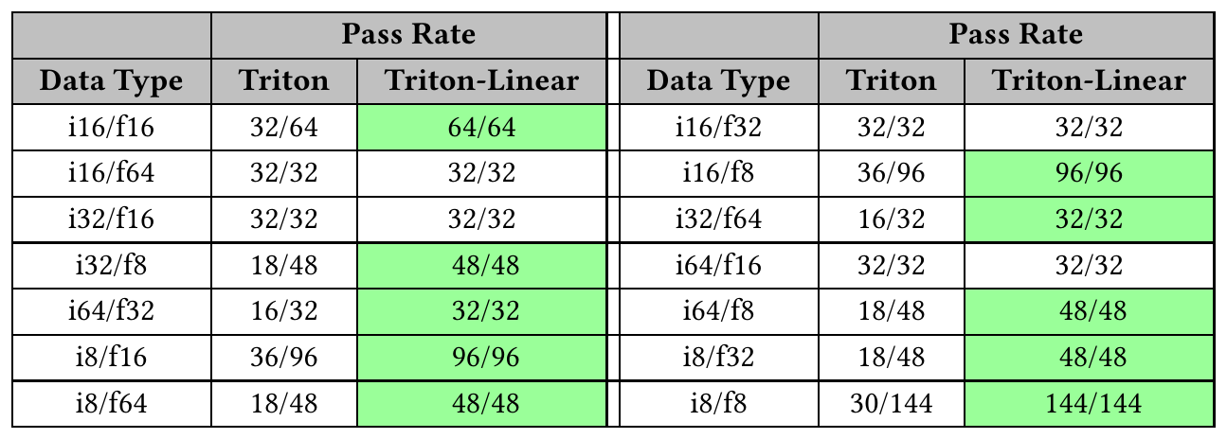
Table 5: correctness of mixed-precision matmul
§6.1 · MIXED-PRECISION MATMUL
What it shows
Pass rate of a mixed-precision matmul for each pair of data types (one per operand).
Experiment
All common Triton data types in pairs, each tested with a simple matmul kernel across shapes — 784 cases in total.
Key notes
Table 5. Pass rate per data-type pair (Triton vs Triton-Linear).
Baseline 366 / 784 (46.6%), Triton-Linear 784 / 784. Legacy Triton failed on small shapes and low-precision types: no MMA layout had more than 32 consecutive bits in the tile’s last dimension.
Source: Table 5 and “Mixed Precision Matmul”, p. 142
Notes:
[~0:45]
Table 5. What it shows: the pass rate of a mixed-precision matrix multiplication for each pair of data types — one type for each operand.
The experiment: all common tensor data types in Triton, enumerated in pairs, each tested with a simple matmul kernel across different shapes: 784 test cases in total.
Key notes. Baseline Triton passes only 366 of 784, 46.6%; Triton-Linear passes all of them. The paper explains why: legacy Triton did not correctly implement matmul for small shapes and low-precision types — it had no MMA layout with more than 32 consecutive bits in the last dimension of the tile — while linear layouts cover every valid distributed layout.

Slide 35
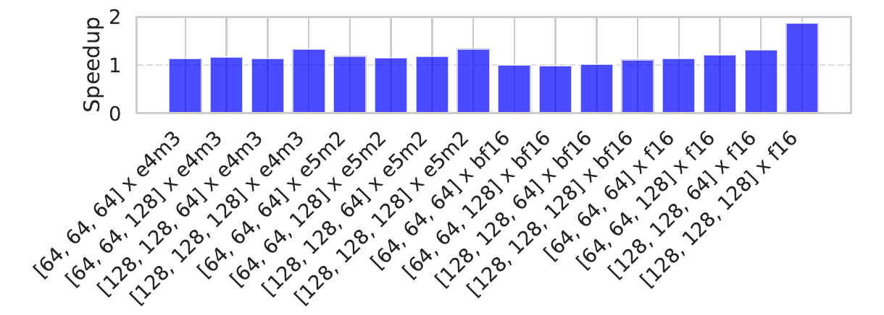
Figure 6: speedup of MXFP4 matrix multiplication
§6.1 · MIXED-PRECISION MATMUL PERFORMANCE
Figure 6. Speedups of MXFP4 matrix multiplications across shapes and data types on GH200.
What it shows
Experiment
Key notes
Speedup = baseline time ÷ Triton-Linear time (> 1 = faster) for MXFP4 matmuls on GH200.
One operand fixed to mxfp4, the other e4m3 / e5m2 / bf16 / f16, several [M, N, K] shapes — tests the data shuffling of §5.2.
Faster in every case (vectorized shared-memory instructions). mxfp4 × f16: 1.87×, partly from also enabling wgmma for f16.
Source: Figure 6 and “Mixed Precision Matmul”, p. 142
Notes:
[~0:45]
Figure 6. What it shows: the speedup of Triton-Linear over Triton — baseline time divided by Triton-Linear time, so above 1 means faster — for MXFP4 matrix multiplications on GH200.
The experiment: one operand is fixed to mxfp4 and the other is varied — e4m3, e5m2, bf16 and f16 — over several matrix shapes. It measures the data-shuffling optimization from Section 5.2.
Key notes. Triton-Linear is faster in every case, because the shuffled operand allows vectorized shared-memory instructions. The mxfp4 × f16 series reaches 1.87×, partly because the authors also fixed a baseline issue where Triton did not use wgmma for f16 in mixed precision.

Slide 36
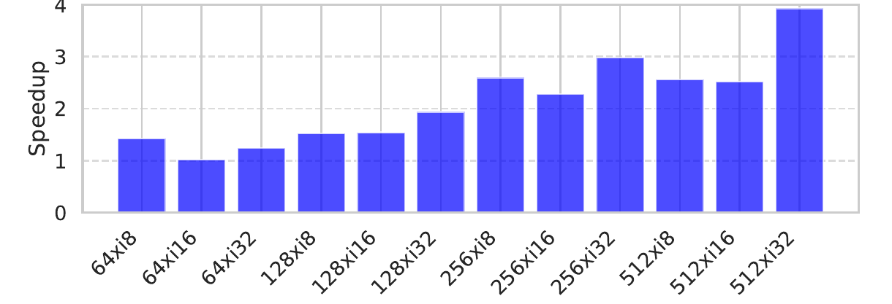
Figure 7: speedup of layout conversions
§6.1 · LAYOUT CONVERSION
Figure 7. Speedups of layout conversions across shapes and data types on GH200.
What it shows
Experiment
Key notes
Speedup of layout conversions on GH200 for different tensor sizes and data types.
Conversions that fit in a warp: Triton-Linear’s warp shuffles (§5.4) vs the baseline, which always goes through shared memory.
Up to 3.93×; larger tensors generally gain more.
Source: Figure 7 and “Layout Conversion”, pp. 142–143
Notes:
[~0:30]
Figure 7. What it shows: the speedup of layout conversions on GH200, across tensor sizes and data types.
The experiment: conversions that can be done with warp shuffles, as in Section 5.4. Triton-Linear uses the shuffle schedule derived from the layouts; baseline Triton always converts through shared memory.
Key notes. Triton-Linear is faster in almost every case, up to 3.93 times, and the speedups are generally larger for larger tensors.

Slide 37
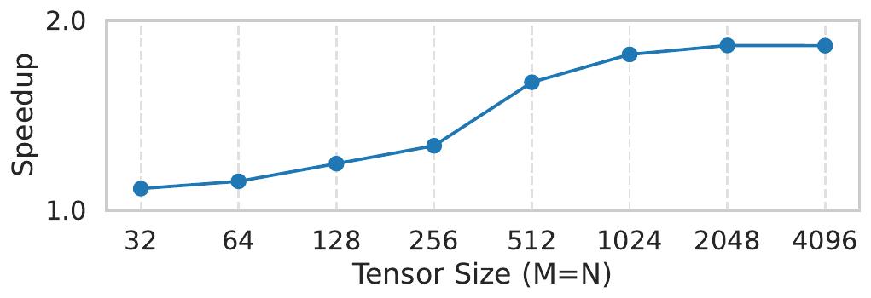
Figure 2: float8 transpose, swizzling vs padding
§1 · SHARED-MEMORY TRANSPOSE
What it shows
Speedup of a float8 transpose over legacy Triton’s shared-memory padding heuristic, for growing M × N.
Experiment
A transpose crosses warps, so both versions use shared memory: the baseline pads rows, Triton-Linear uses the optimal swizzle of §5.4. (Shown in the introduction; no further setup given.)
Figure 2. Speedups over the padding heuristic in a float8 transpose kernel (M × N tensors).
Key notes
From about 1.1× (small) to about 1.85× (largest), read off the plot.
Source: Figure 2 and §1 Introduction, p. 133; §5.4 (optimal swizzling)
Notes:
[~0:45]
Figure 2 comes from the paper's introduction. What it shows: the speedup of a float8 transpose kernel for M by N tensors of growing size, compared with legacy Triton's shared-memory padding heuristic.
The experiment: a transpose moves data across warps, so both versions go through shared memory. Legacy Triton pads each row to avoid bank conflicts; Triton-Linear uses the swizzled layout constructed in Section 5.4. The paper gives no further setup details for this figure.
Key notes. The speedup grows from about 1.1 times for small tensors to about 1.85 times for the largest ones, read off the plot: swizzling keeps accesses wide and conflict-free without the padding.

Slide 38
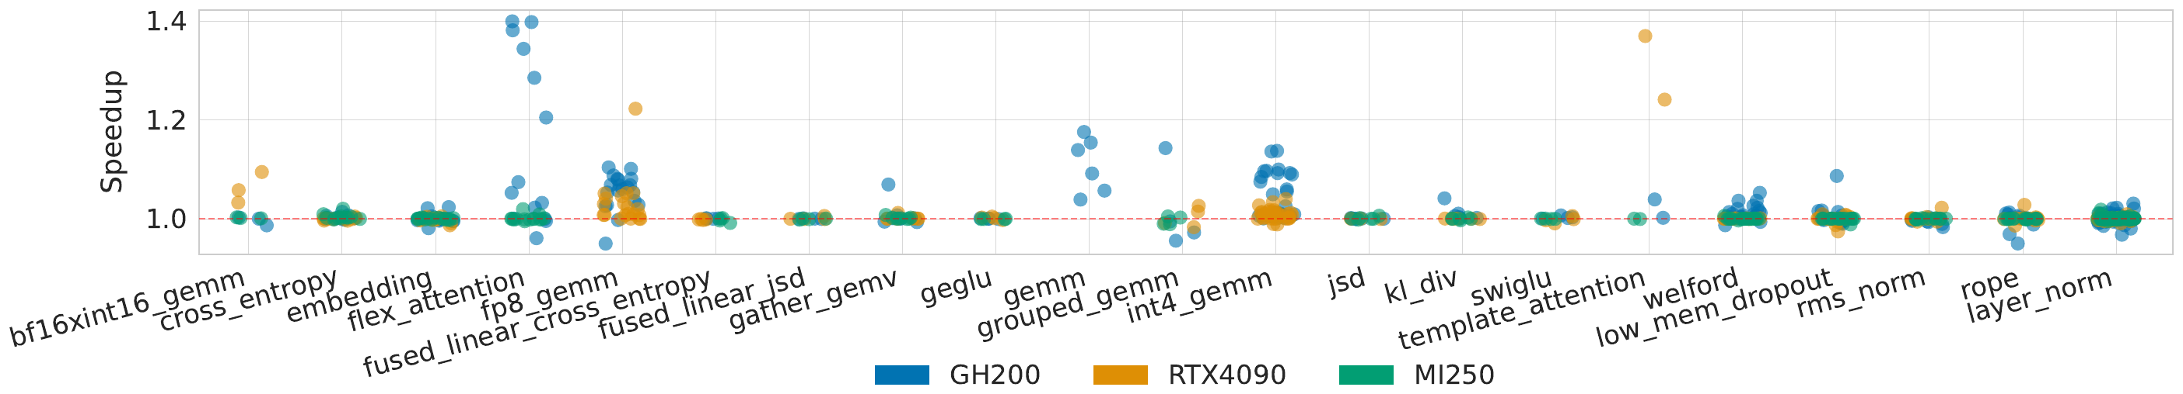
Figure 9: speedups on 265 TritonBench cases
§6.2 · REAL BENCHMARKS
Figure 9. Speedups of real benchmarks on RTX 4090, GH200 and MI250 (each dot = one input case).
What it shows
Experiment
Key notes
Speedup of Triton-Linear over Triton on real kernels; each dot is one input case, coloured by GPU.
21 TritonBench benchmarks, 265 cases, three GPUs, timed by TritonBench. Some benchmarks are missing on some GPUs (hardware limits).
GH200 0.96–1.40× (int4_gemm, gemm, flex_attention), RTX 4090 0.97–1.37×, MI250 1.00–1.03× (no ldmatrix-like primitives). Values below 1 are mostly noise on small inputs.
Source: Figure 9 and §6.2, pp. 143–144
Notes:
[~1:00]
Figure 9. What it shows: the speedup of Triton-Linear over Triton for real kernels. Each dot is one input case, coloured by GPU.
The experiment: 21 benchmarks from TritonBench, 265 input cases in total, on all three GPUs, timed by TritonBench's own reporting. Some benchmarks are missing on some GPUs because of hardware limits.
Key notes. On GH200 the speedups range from 0.96 to 1.40 times; the largest are int4_gemm, gemm and flex_attention, which use ldmatrix and stmatrix in conversions and shared-memory traffic, and for welford a conversion between equivalent layouts becomes a no-op. On the RTX 4090, 0.97 to 1.37 times, with template_attention gaining more than on GH200 because there the operand goes through ldmatrix rather than wgmma reading shared memory directly. On the MI250, 1.00 to 1.03 times, because AMD lacks efficient primitives like ldmatrix. Values below 1 are mostly runtime noise on small inputs.

Slide 39
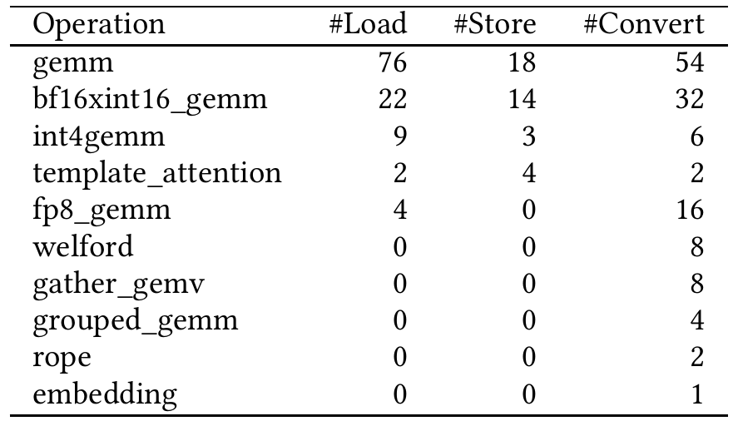
Table 6: where the real-benchmark gains come from
§6.2 · REAL BENCHMARKS
What it shows
For each benchmark: the number of shared-memory loads, stores and layout conversions in its Triton GPU IR.
Experiment
Counted in the compiled IR of each TritonBench kernel (static counts); benchmarks without such operations are omitted.
Key notes
Kernels with many of these operations (gemm: 76 loads, 18 stores, 54 converts) gain most — the speedups come from making exactly these operations cheaper.
Table 6. Shared-memory and convert_layout operations per benchmark.
Source: Table 6 and §6.2, p. 143
Notes:
[~0:30]
Table 6. What it shows: for each benchmark, how many shared-memory loads, shared-memory stores and layout conversions its Triton GPU IR contains. Benchmarks with none of these operations are left out.
The experiment: the authors count these operations in the compiled IR of each TritonBench kernel. These are static counts in the IR, not counts of executed instructions.
Key notes. The kernels with many of these operations — gemm has 76 loads, 18 stores and 54 conversions — are the ones that gain most, which confirms that the benefits come from making exactly these operations cheaper.

Slide 40
What the results show overall
§6 · ANALYSIS
Robustness: layouts the baseline could not handle now work (MMA Input, Sliced MMA, custom); mixed-precision tests go from 366 / 784 to 784 / 784.
Code generation: up to 128-bit accesses, up to 76% fewer shared-memory instructions, warp shuffles instead of shared memory for layout conversions (up to 3.93×).
End to end: average 1.07×, maximum 1.40× over 265 real cases; depends on GPU and kernel.
Why smaller than the micro-benchmarks: a kernel spends only part of its time in these operations (Amdahl’s law); gains are also smaller on AMD, which lacks ldmatrix-like instructions.
Source: Abstract, §1 and §6, pp. 132–133, 142–144
Notes:
[~0:45]
To sum up the evaluation in four points.
Robustness: layouts that legacy Triton could not handle now work — MMA input, sliced MMA, custom layouts — and mixed-precision correctness goes from 46.6% to 100% of the tested cases.
Code generation: wider vectorized accesses, fewer shared-memory instructions, and warp shuffles instead of shared memory for layout conversions.
End to end: on average 1.07 times and at most 1.40 times over 265 real cases, depending on GPU and kernel.
Why so much smaller than the micro-benchmark numbers? A real kernel spends only part of its time in conversions and shared-memory accesses, so a large speedup on that part becomes a small one for the whole kernel. And the gains depend on hardware: smaller on AMD without ldmatrix-like instructions.

Slide 41
Conclusions and limitations
§8 · CONCLUSIONS
Conclusions
Limitations and future work
Linear layouts are the first theoretical foundation and implementation for mapping between complex hardware resources and logical tensors.
They are complete under Triton’s shape operators (proved in the paper).
They support efficient code generation: vectorization, broadcasting, mixed precision, hardware primitives, warp shuffles, swizzling.
Experiments: a more robust Triton compiler and non-trivial speedups.
Power-of-two shapes only — mitigated by defining larger tensors and masking out-of-bound elements.
Not everything is linear: some operations cannot be expressed with linear layouts and need an extension of the representation.
Future work: combine linear layouts with hardware measurements into a performance model for autotuning.
Source: §8 Conclusions, p. 144
Notes:
[~1:00]
To conclude, in the paper's own terms.
Linear layouts are the first theoretical foundation and implementation for mapping between complex hardware resources and logical tensors. The paper proves that linear layouts are complete under Triton's shape operators, and it builds efficient code generation on top of them — vectorization, broadcasting, mixed precision, hardware primitives, warp shuffles and swizzling. The experiments show that linear layouts make the Triton compiler more robust and also deliver non-trivial performance improvements.
The limitations, as the authors state them. The main one is the restriction to power-of-two shapes; it can be mitigated by defining larger tensors and masking the out-of-bound elements. Some operations cannot be expressed with linear layouts alone; they need an extension of the representation. As future work, the authors plan to combine linear layouts with hardware measurements into a performance model for autotuning kernels.

Slide 42
Questions?
Thank you
1
0
0
0
0
0
0
0
0
0
1
0
0
0
0
0
0
0
0
1
0
0
0
0
0
0
0
0
1
0
0
0
0
1
0
0
0
0
0
0
0
0
0
0
0
1
0
0
0
0
0
0
0
0
1
0
0
0
0
0
0
0
0
1
Paper: https://doi.org/10.1145/3760250.3762221
arXiv: https://arxiv.org/abs/2505.23819
Code: https://github.com/triton-lang/triton
Lecture: GPU MODE lecture on linear layouts (P. Bell, M. Lezcano, K. Zhou)
Notes:
[~5:00] Q&A.
Likely questions and short answers:
- Why hardware → tensor and not the reverse? Duplicates make the reverse not a function; right inverses pick one preimage when needed.
- Non-power-of-two shapes? Pad to a power of two and mask (paper's stated workaround); LinearLayout.h also notes LLs cannot represent padded layouts.
- How does this compare to CuTe? Paper §7: CuTe is a user-facing layout algebra; linear layouts are integrated into the compiler, labelled, include swizzling as part of the layout, and enable automatic conversion/codegen. LinearLayout.h has a similar comparison.
- Is anything solved at runtime? No — all matrix work is compile-time; runtime executes generated loads/shuffles/stores (index math is XOR/shift).
- Why are end-to-end gains small? Amdahl: conversions are a fraction of kernel time; AMD lacks ldmatrix-like primitives in the evaluated implementation.
- Where is the code? Upstream triton-lang/triton: include/triton/Tools/LinearLayout.h (representation), lib/Tools/LinearLayout.cpp (operations), LinearLayoutConversions.cpp (legacy layouts → linear layouts), RemoveLayoutConversions.cpp (layout engine). Current main, not the paper's exact revision.

